Slide 1

The event will begin momentarily.
This event is being recorded
Captions are available by clicking the CC icon in the Zoom toolbar below
ASL is provided
Presentation materials are available at:
www.access-board.gov

Slide 2
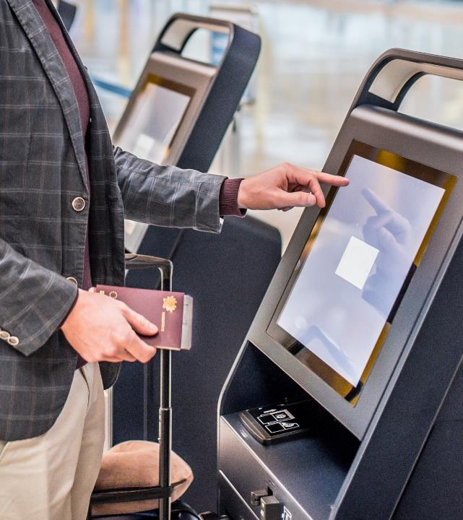
Inclusive Interfaces: Accessibility of Self-Service Transaction Machines

Slide 3
Agenda
Panel 1: Accessibility Challenges Presented by Self-Service Transaction Machines
Overview of Existing ADA and Section 508 Standards Relevant to Self-Service Transaction Machines
Panel 2: Current Efforts to Improve Accessibility of Self-Service Transaction Machines

Slide 4
Welcome!
The purpose of this event is to hear from individuals on the current accessibility (or inaccessibility) of self-service transaction machines.
Our speakers have been invited to share information this topic; however, their inclusion in this event does not constitute an endorsement by the Access Board of any organization, product, service, or technical solution.

Slide 5
Panel 1:
Accessibility Challenges Presented by Self-Service Transaction Machines
Mark Hill
Deaf and Hard of Hearing Consumer Advocacy Network
Donald D. Overton, Jr.
Blinded Veterans Association
Clayton Lewis
Coleman Institute for Cognitive Disabilities
Dave Pierson
United Spinal Association

Slide 6

Next presenter…

Slide 7
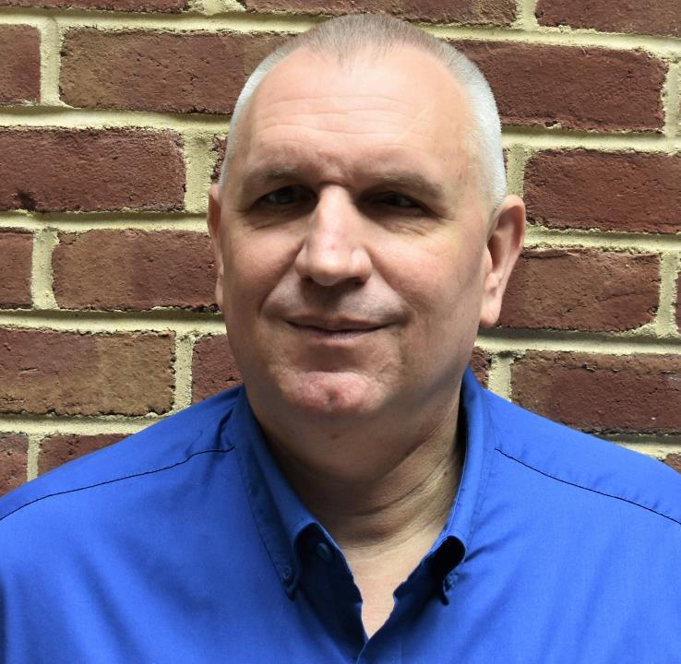
Donald D. Overton, Jr. Blinded Veterans Association

Slide 8
Next presenter…

Slide 9
SSTM Barriers for People with Cognitive Disabilities
Clayton Lewis
Co-Director for Technology
Coleman Institute for Cognitive Disabilities
University of Colorado
Many thanks for input from: Stefan Carmien, Emily Shea Tanis, Nancy Ward

Slide 10
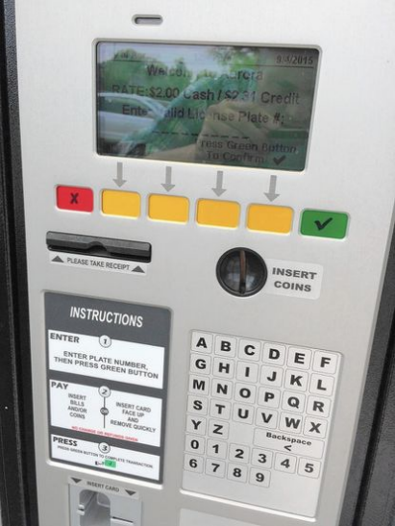
Difficulty Reading
Small letters and symbols, low contrast, and glare all cause problems.
Note that these problems are more serious for people with cognitive challenges, because reading under difficult visual conditions creates more cognitive demands.
Spoken prompts can help.

Slide 11
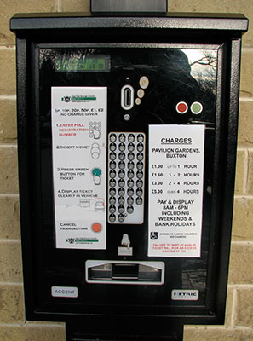
Small Keys and Buttons
These cause trouble in themselves, but also increase difficulty of use by making error correction more often necessary.
Touch screen interaction can support larger buttons with clearer cues.

Slide 12
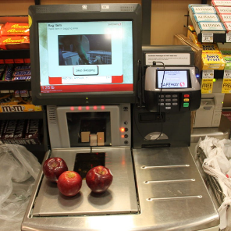
Difficulty with Payment
It can be hard to see where to insert a chip card.
the old swipe slots were easier to see
tap can be good, too, if it’s clear where to tap
When the payment device is not integrated with the main interaction, confusion can result.

Slide 13
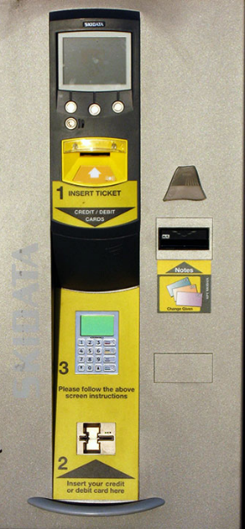
Managing Error
Simple logic is important for users generally, and must be verified by testing.
The impact of this is especially large for people with cognitive disabilities
Support corrections without restarting whole transaction
Avoid timing out users who need more time to get things right

Slide 14
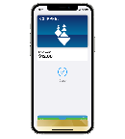
Personalization?
People with disabilities don’t like special “accessible” machines… all machines should be equally usable.
Personalization could be a way to support diverse requirements, but universal design is simpler.
Pass systems (smart cards or phones) may dominate explicit personalization in many applications (parking, transit).
Regular customers need not interact with SSTM at all, so SSTM can be biased toward novice customers.

Slide 15
Thank you!
Some examples: www.userfocus.co.uk/articles/car-park-payment-machines.html (Dr David Travis)

Slide 16
Next presenter…

Slide 17
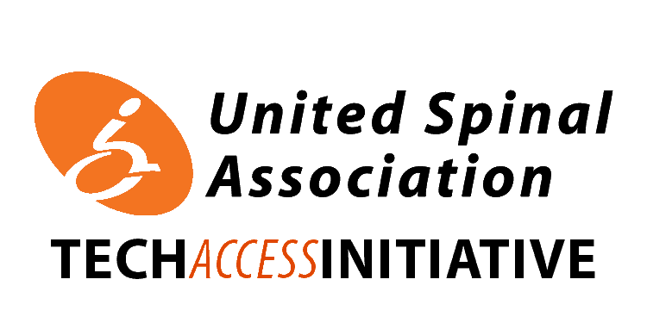
Accessibility to Self-Service Transaction Machines
Physically Disabled Perspective – Spinal Cord Injury (Partial Paralysis)

Slide 18
Spinal Cord Injury Primer
Quadriplegic/Tetraplegic – All four limbs & core affected by some form of paralysis
Paraplegic – Legs & to a lesser extent the core is affected by some form of paralysis
No two injuries are the same
My Specific Physical Afflictions
Unable to pinch with fingers
Unable to grab with hands
Very limited core control – rely on arms/armrests/tilt to balance my upper body
Grab items by sandwiching between two hands – severely limits reach

Slide 19
SSTMs Issues – Physical Space
Background
Power Wheelchair occupies ~6ft radius
In sitting position my feet prohibit interaction in front of me
All interactions are done to my left or right sides
Issues
Multiple SSTMs in a row pose issues entering/exiting….feels like parallel parking
Some SSTMs simply do not have enough physical space

Slide 20
SSTMs Issues – Height
Background
Wheelchair sits lower than most ambulatory people
Wheelchairs require everything to be a little lower
Issues
Distance to CC Reader is too far to enable reaching with two hands to pull card
Some SSTMs print receipts too high to reach
What Works
NFC (Near Field Communication) Readers (Apple Pay, Tap To Pay)
Scan to pay (3D Code)
Scan while you shop

Slide 21
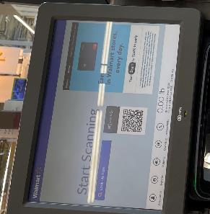
SSTMs Issues – Screens
Background
Wheelchair sits lower than most ambulatory people
Wheelchairs require everything to be a little lower
Issues
Screens are often too high to read
Glare on screen
What Works
Ability to significantly tilt screen
Matte anti-glare screens opposed to glossy screens

Slide 22
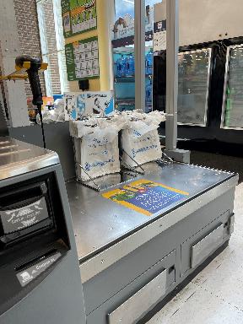
SSTMs Issues – Bagging
Background
Wheelchair sits lower than most ambulatory people
Wheelchairs require everything to be a little lower
Grab items by sandwiching between two hands – severely limits reach
Issue
Bags are often not reachable
What Works
Place bagging station at end opposed to back

Slide 23
Next presenter…

Slide 24
Overview of Kiosk Accessibility Regulation
Bruce Bailey, IT Specialist
U.S. Access Board
May 19, 2021

Slide 25
Kiosks, AKA…
Interactive Transaction Machines
Information Transaction Machines
Self-Service Kiosks
Self-Service Transaction Machines

Slide 26
Regulatory Statutes
Access Board Purview
Architectural Barriers Act (ABA)
American with Disabilities (ADA)
Section 508 of the Rehabilitation Act
Other Agencies
Air Carrier Access Act (ACAA) — DOT
Help America Vote Act (HAVA) — EAC

Slide 27
Chronology
2000 Section 508 EIT Accessibility Standards
2002 Help America Vote Act (HAVA)
2004 Updated ABA and ADA Accessibility Guidelines
2010 DOJ adopts updated ADA Standards
2013 ACAA Amendments
2017 Revised Section 508 ICT Accessibility Standards

Slide 28
Key Questions
What term is used?
What is the application/scoping?
Is it required to talk?

Slide 29
Original Section 508 Standards
1194.25 Self contained, closed products.
Applicable to hardware other than kiosks.
Does not explicitly require speech output:
Self contained products shall be usable by people with disabilities without requiring an end-user to attach assistive technology to the product.

Slide 30
Help America Vote Act
(3) Accessibility for Individuals with Disabilities. —
The voting system shall —
be accessible for individuals with disabilities, including nonvisual accessibility for the blind and visually impaired, in a manner that provides the same opportunity for access and participation (including privacy and independence) as for other voters;
satisfy the requirement of subparagraph (A) through the use of at least one direct recording electronic voting system or other voting system equipped for individuals with disabilities at each polling place;

Slide 31
ABA & ADA Standards
F220/220 Automatic Teller Machines and Fare Machines
“automatic teller machines or self-service fare vending, collection, or adjustment machines”
707 Automatic Teller Machines and Fare Machines
707.5 Speech Output
Machines shall be speech enabled.

Slide 32
ACAA and “Automated Airport Kiosks”
14 CFR § 382.57
What accessibility requirements apply to automated airport kiosks?
(5)(i) Speech output enabled.

Slide 33
Revised Section 508 Standards
Chapter 4: Hardware
402 Closed Functionality
402.2 Speech-Output Enabled
ICT with a display screen shall be speech-output enabled for full and independent use by individuals with vision impairments.

Slide 34
Next presenter…

Slide 35
Panel 2:
Current Efforts to Improve Accessibility of Self-Service Transaction Machines
Craig Keefner
Kiosk Manufacturer Association
Gregg Vanderheiden and Bern Jordan
Trace Research and Development Center
Phil Day
NCR
Laura Boniello Miller
Vispero

Slide 36
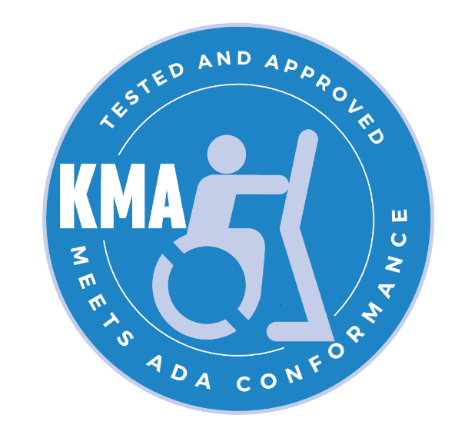
The Kiosk Association which is the Kiosk Manufacturer Association aka KMA
Our mission
Inform
Educate
Improve Unattended Self Service & Kiosks
Regulatory Focus
ADA - US, Europe, UK, Korea, Asia
PCI (Cardholder Activated Terminals)
UL Standards
HIPAA
FDA (temperature scanning)
Medical 60601
Gaming GLI
VPAT
WCAG

Slide 37
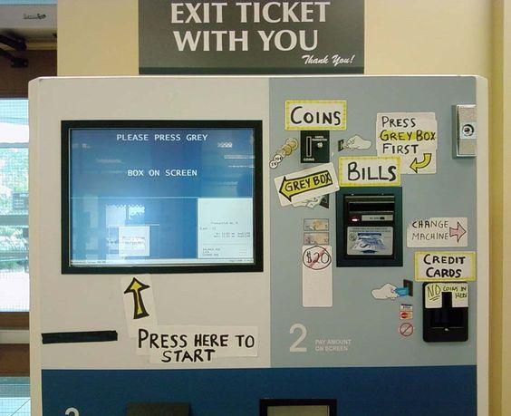
The Need for Access Standards
Days of old

Slide 38
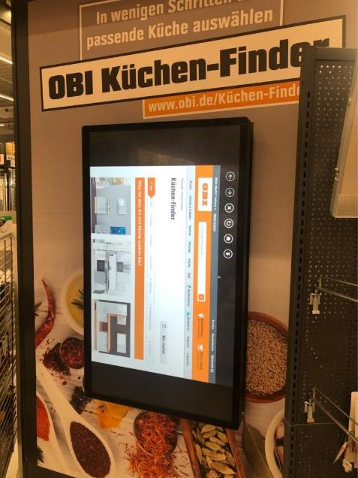
The Need for Access Standards
Companies with internal IT geeks tell us all the time that, “Not to worry. We got usability figured out.”
Then they save some money and do this.
There are far too many “Not the best idea” examples and we have a whole photo gallery dedicated to them.
Internal IT department personnel are very skilled in internal network operations. Not so experienced in public facing

Slide 39
The Need for Accessibility – Misconceptions & Barriers
Common misconceptions about kiosks and ADA compliance:
A simple paragraph declaring “must be ADA compliant” is sufficient
ADA only applies to wheelchair access
If there are store personnel available to help the disabled person then no need to comply
An audio jack by itself satisfies ADA access for people with vision impairments
Installation and site considerations are overlooked
Barriers to ADA compliance:
Developing or Revising the user interface (software) to incorporate text to speech is cost prohibitive
ADA compliance is too complicated, and the standards are too vague
Confusion about which department’s accessibility standard for kiosks should apply
State laws vary — California versus Alabama e.g.
Companies may do cost analysis vs liability and decide against (Casinos e.g.)
Accommodating multiple devices within a small accessible “strike zone” is a challenge at times

Slide 40
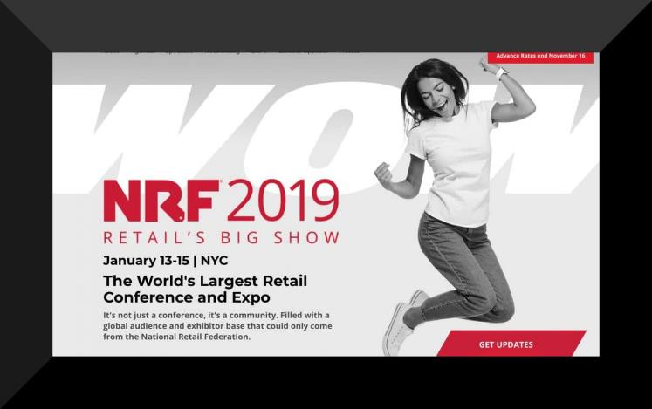
How KMA Promotes Access To Kiosks and Self-Service
Tradeshows
Retail (NRF)
Restaurants (NRN)
Hospitality
Relations
RNIB
IAAP
NFB
Patent Reform
Legal Case Monitor
Monthly Newsletters (9,000)
LinkedIn (2M)
PRNewswire monthly
ADA 14-Point Checklist
ADA Code of Practice
WCAG 2.1 Checklist

Slide 41

Promote Access
How KMA Promotes Access To Kiosks and Self-Service
Speaking engagements
Proposed and proposing new working group for PCI-SSC named “Integrated Cardholder Activated Terminals” or ICAT (cousin of ICT)
Audio and integrated QR readers are next generation in v5.
No commissioning required.
See our PCI Update

Slide 42
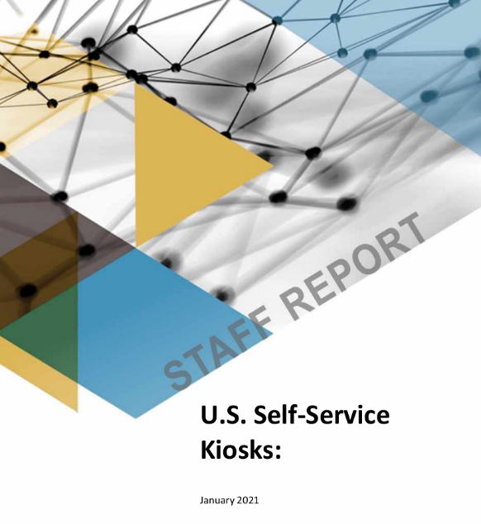
Market Research
Community directed and peer reviewed research. Not your typical internet scrape.
We are happy to provide a free copy of up to any three reports to registered viewers today. Sorry, but kiosk companies are not included… Contact craig@kma.global or call
2021 Kiosk Market
US Retail Ecommerce
NRA State of 2021
2021 Payments EcoSystem
IAAP Whitepaper
50 other verticals and reports

Slide 43
U.S. Self Service Applications
Market Applications
These are “functional” applications that extend from one market segment to another.
Checking in at a hospital patient kiosk is not much different from a hotel check-in or a ticketing check-in.
First Name, Last Name, Address, Phone + some sort of token credential.
A virtual fixed interface
Check-in
Check-out
Ticketing
Self-Order (McDonalds e.g.)
Banking
Bill Pay
Digital Menu
Bitcoin
Temperature
Touch Screen Form Factors from 5" to 85"
Payment: Mag Stripe Card, EMV Card, NFC Card, Cash, Check, Text, QR, Facial, other Biometrics and BNPL)

Slide 44
U.S. Self Service Markets
Market Research
Market segments have differences.
HIPAA privacy concerns are paramount in healthcare.
PCI is paramount in transactional payment.
Accommodating the required devices in shrinking zone is one of the challenges for kiosk manufacturers.
Hospitality
Entertainment (Ticketing e.g. Disney or AMC)
Healthcare
Financial
Food Service
Travel (CLEAR e.g.)
Transportation
Government (Federal, State, City)
Education
Gaming (Loyalty & Sports Betting)

Slide 45
Market Numbers for 2019 thru 2025
User | 2019 | 2020 | 2021 | 2022 | 2023 | 2024 | 2025 | CAGR% 2020-2025
Retail | 453 | 340 | 411 | 465 | 540 | 626 | 724 | 16
Healthcare | 312 | 299 | 379 | 450 | 527 | 615 | 715 | 19
Financial | 329 | 285 | 347 | 407 | 480 | 566 | 669 | 19
Travel | 380 | 312 | 373 | 424 | 482 | 545 | 614 | 14
Hospitality | 406 | 283 | 329 | 373 | 422 | 474 | 530 | 13
Gov | 241 | 177 | 205 | 232 | 262 | 293 | 324 | 13
Restaurant | 177 | 140 | 173 | 203 | 237 | 276 | 320 | 18
Education | 87 | 62 | 71 | $82 | 94 | 107 | 121 | 14
Others | 227 | 177 | 200 | 233 | 271 | 313 | 360 | 15
Total | $2,611 | $2,074 | $2,488 | $2,867 | $3,314 | $3,816 | $4,379 | 16

Slide 46
Thanks -- For more information
Craig@kma.global | 720-324-1837
Websites
Kiosk Industry
KMA Association
Automated Retail
Self Service Industry
Patient Healthcare
Thin Client Computing
Point-of-Sale RFPs
Smart City Design
Digital Signage Solutions
Touch Screen Technology
Digital Menu Board
Check-In
Self-Service Kiosk Consulting

Slide 47
Next presenter…

Slide 48





Accessible Kiosk Strategies
Part of the SSTM/Kiosk Accessibility Panel
Hosted by the U.S. Access Board - May 19, 2021
J. Bern Jordan, Ph.D.: jbjordan@umd.edu

Slide 49
Accessibility requires both hardware and software to work together
Cannot make a kiosk accessible though – design of the physical kiosk only – or through software only
However, I will focus mostly on the software side today

Slide 50
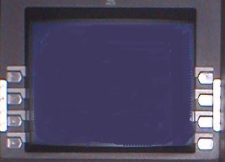
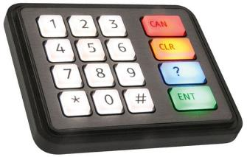
Two Major Accessibility Strategies:
1) Direct selection (with “Cue and Respond” for non-visual access)
View (or listen to) a menu
Make a choice by pressing a button (or entering a code)
System does not rely on timing of button press

Slide 51
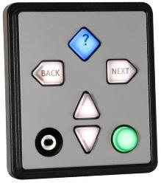
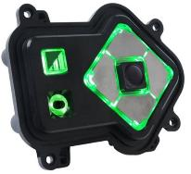
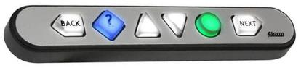
2nd Major Accessibility Strategy
2) Navigation (with speech feedback via headphone for non-visual access)
Use arrow buttons to move cursor through elements on screen (spoken through headphones)
Use “Activate” button on the desired one
Linear navigation ensures non-visual discovery of everything on the screen

Slide 52
Demonstration
of both approaches
http://youtu.be/5G61H2hhdeo

Slide 53

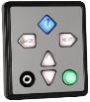
Comparison of 2 approaches
Direct-Selection (cued)
Navigation
(+) Familiar to most (phone menus)
(+) Simplest to understand and use. (instructions are integral part of cuing)
(–) Practically limited to menus of up to 8 or 9 choices (or cues are more complex)
(–) Inefficient when there are many choices
(–) Limited to simple, choice-based interfaces
(+) More efficient because a person can move at own pace
(+) Can navigate & activate relatively complicated interfaces
(+) Only real option with large number of selections
(–) Although obvious for those who can see and those who use screen readers and self-voicing products – it is not as easy as Cue & Respond for new users without instruction

Slide 54
WINNER for Public Kiosks?
Cue and respond ** when appropriate
small number of simple choices
keypad is present
Navigation – otherwise
** Never use Cue and Respond without keypad (e.g., “For X, press now”). That requires timing.

Slide 55
Other Complimentary strategies (can be used along with – not as primary method)
PROs and CONs
(+) All of these strategies can be very efficient
(+) Some people will already be familiar
Talking Fingertip
(–) Not reliable for people with no or very limited vision. Might miss things on the screen
Swipe to Step-Scan
(–) Harder to discover/ learn /describe without training
(–) Easier to accidentally activate things.
(–) Not all people have dexterity to make clean swiping gestures – errors cause jumps (& confusion)
Speech Input
(–) Some people cannot speak or speak clearly
(–) Interaction can be frustrating when it isn’t going perfectly
“Talking Fingertip”
Touch / slide across onscreen elements
Items are spoken as they are touched
Activate with a button or gesture
“Swipe to Step-Scan”
Each finger swipe advances to next item which is read – in linear order
Activate with a button or gesture
Speech Input
Can be very simple if/where it works – User just says what they want to do

Slide 56

Thank You
This work was supported in part, by grant number 90REGE0008 (Inclusive ICT Rehabilitation Engineering Research Center) National Institute on Disability, Independent Living, and Rehabilitation Research, U.S. Administration for Community Living, Department of Health and Human Services
Grantees undertaking projects with government sponsorship are encouraged to express freely their findings and conclusions. Points of view or opinions do not, therefore, necessarily represent official policy of the Federal Government
Image Credits
Numeric keypad & Navigation controls from Storm Interface
ATM screen with button on the side in the public domain from Rfc1394 on Wikipedia Commons

Slide 57
Next presenter…

Slide 58
Title slide
NCR Kiosk Accessibility
Phil Day, User Centered Design
May 2021

Slide 59
Introductions
NCR
NCR powers the technology that helps our customers to run their restaurant, bank or store.
User Centered Design
Multidisciplinary – industrial design, interaction design, usability & accessibility
US & UK
Design the hardware products for Banking, Retail & Hospitality

Slide 60
Research that led to Universal Navigator
Trend to touchscreens, and larger displays
Wanted a complementary input device to make products accessible to those with low visual acuity, poor upper body mobility or poor manual dexterity
Multiple concepts were created, tested & either discarded or refined
Several user tests & refinement led to the current design
Detailed results have been published in peer-reviewed conference proceedings

Slide 61
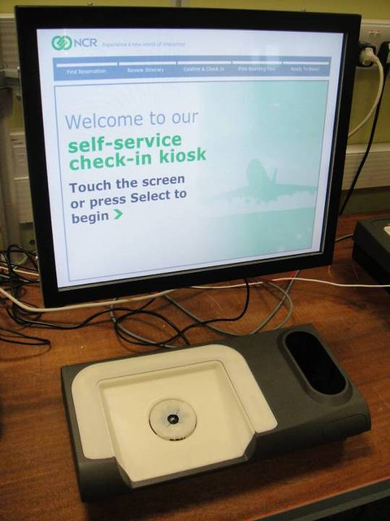
User tests - uNav
Initial testing – 25 NCR staff
Results identified a preferred concept & input method which was then refined before another round of user tests
Photo of a display above a prototype input device with up, down, left, right buttons arranged in a circle around a central OK button

Slide 62
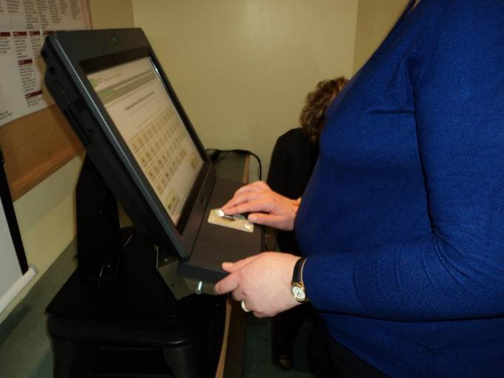
User tests – uNav - London
Partnered with RNIB
Tested with refined, higher fidelity prototype
48 participants (27 M, 21F)
47% blind without any useful residual vision
32% blind with some useful residual vision
21% partially sighted
Photo of a person using a prototype uNav on a shelf below a 15” touchscreen displaying an onscreen keyboard

Slide 63
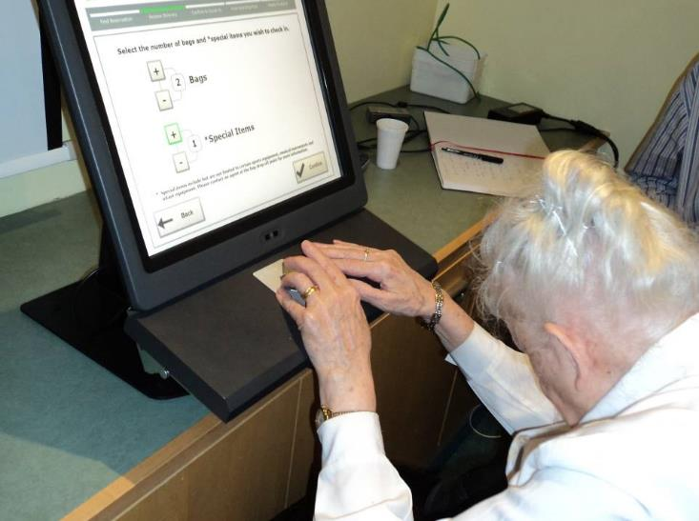
User tests – London
All said uNav was acceptable
Common question at the end; “how soon will this be available”?
Photo of a person using the same setup with a bag selection screen

Slide 64
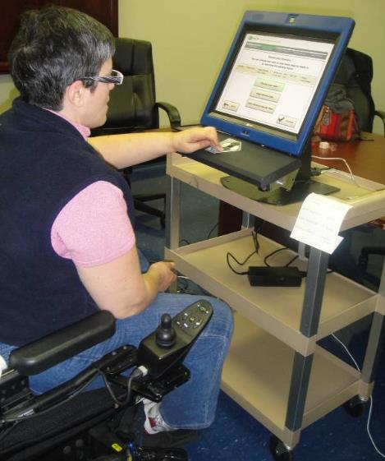
User tests – uNav - Atlanta
Slight improvements to software as a result of London testing
Test at Disability Link (range of physical impairments) & Center for Visually Impaired
20 Participants with
Mobility impairments
Reduced manual dexterity
Blind
Partially sighted
Or combinations of the above
Similar findings to London
All managed to successfully complete the task using the uNav
All felt that it was acceptable
Photo of a person in a wheelchair using the same setup with a menu screen

Slide 65
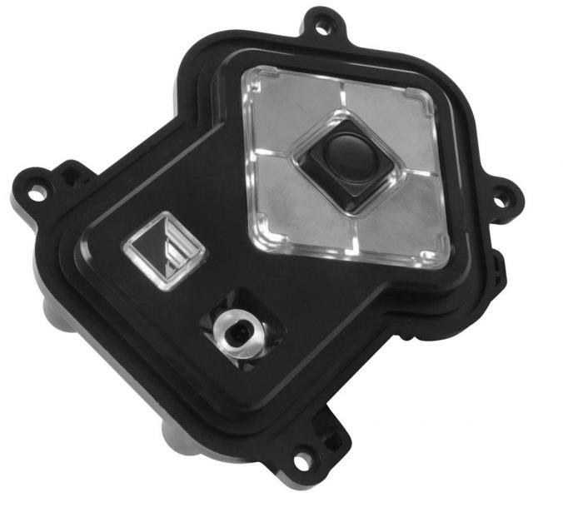
Production - uNav / AudioNav
Partnership
Design concept by NCR
Developed and engineered by Storm Interface
RNIB “Tried & Tested” accreditation
Also available to other vendors
Photo of the production uNav, with 4 buttons (up, down, left, right) arranged in a diamond shape around a central select button. An audio jack and volume button are located to the left of the uNav. The keytips, audio socket and volume button also illuminate, and tactile features are used to differentiate each button.

Slide 66
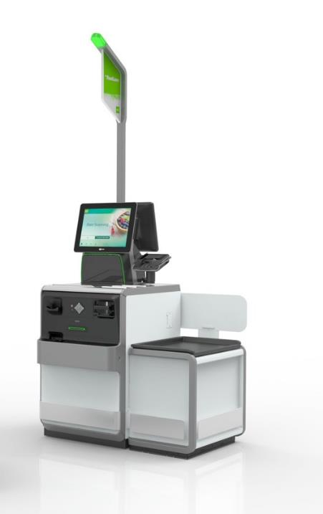
Integration - SCO
uNav has been integrated into our self-checkout (SCO R6)
Picture of a self-checkout unit. The main device consists of a scanner/scale at waist height, with a touchscreen above this, and an illuminated signage pole at the top. Below the scanner/scale are devices to accept cash, with coins on the left and notes on the right. The uNav is placed in between the 2 cash modules, with a receipt slot beneath it. There is a bagging area located to the right of the main unit.

Slide 67
Integration - kiosk
uNav also available with kiosks like the XK22 – a kiosk that can be used for food ordering
Picture of a wall-mounted, 22” portrait touchscreen kiosk. The screen is at the top, with an angled surface with the uNav on the left, a contactless card reader in the middle, and a combined card and keypad payment device on the right. Below these there is a receipt slot and a barcode scanner on a vertical surface.

Slide 68
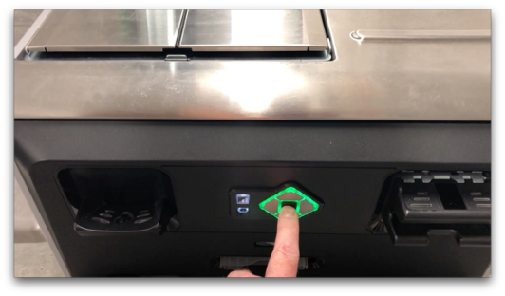
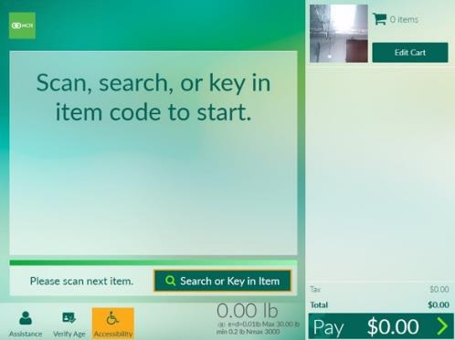
uNav in use
Photo of a person pressing the central uNav button. uNav illuminates with green light around the direction buttons, and white light around the audio jack and volume
Activate accessibility mode – press central button
uNav lights up, speech begins (through headphones)
Left & right take you through each option in turn
Up/down take you to the previous or next block of instructions
The currently selected option is shown visually onscreen, and vocalized via the headphone jack
Picture of self-checkout screen. Currently selected option (Search) has a coloured border, accessibility button is also highlighted

Slide 69
Conclusions
Thanks for the work on creating & refining accessibility standards
Importance of harmonization – we now track 55 accessibility standards (for self-service) in 48 countries – which unfortunately differ & sometimes conflict in their technical detail
ADA section 707 seems to offer a well-defined set of requirements that could be applied more broadly
If additional software requirements are needed WCAG has been widely adopted
These requirements also harmonize with EN 301 549, which has been adopted not only in Europe, but also in Australia (and potentially Canada)
Future standards (kiosks, and ATM updates) should allow for newer technologies (such as touchscreens, voice, gestures, interaction with smartphones/wearables) so everyone has the opportunity to use innovative and usable new solutions

Slide 70
THANK YOU
phil.day@ncr.com
linkedin.com/in/philday

Slide 71
Next presenter…

Slide 72

Screen readers and Kiosk Accessibility
Laura Boniello Miller
Corporate Business Development Manager

Slide 73
What is a Screen reader?
Providing dynamic voice output that changes as the content on the kiosk changes
Voice input and voice output available
Examples of both shown via videos
Video 1: Slot Machine

Slide 74
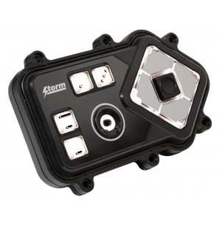
The Power of JAWS
Most popular screen reader worldwide
Product has been selected by SSA, Wells Fargo, Carnival Cruise Line and others for implementation in Kiosks
JAWS supports over 30 languages with more each year
User can customize but the settings reset between users
Same interface for all customers (no separate accessibility mode)
Configured to work with the Storm Audio Nav Keypad, & other input devices
Installed locally – No servers or internet connection required

Slide 75
Features of JAWS
Supports headphone jack detection
User specific configuration; default user experience
Speed
Volume
Verbosity Level
Languages and Voices
Customizable, context specific help interaction
Ability to use headings to move between sections
Dictionary file to ensure correct pronunciation
Reset to standard mode when headphones are removed
Ability to customize introduction when accessibility mode activated

Slide 76
User Customizations
Events that start or stop JAWS
Inserting or removing headphones
Pressing a key or key combination on a keyboard or keypad
Application reset or timeout
Speech volume
Voice rate or pitch
Voice person selection (includes dozens of choices)
Verbosity level
Language selection

Slide 77
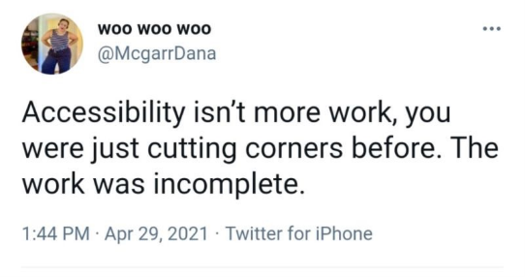
Thoughts
Broadening definition of “kiosk”
Responsibility is on deployers to know what is “accessible” for kiosks
Measurable/Testing required
Curb cuts = Accessibility helps everyone

Slide 78
Questions?
Laura Boniello Miller
Corporate Business Development Manager
US Mobile: 717-989-8657
lmiller@Vispero.com

Slide 79
Next presenter…

Slide 80
Meeting of the U.S. Access Board will resume with regular business at 3:30 p.m.

